Slide 1
Aircrafts maintenance planification system

Slide 2
1 - Definition of the system
Aircraft maintenance planning software.
Sets of tasks to do in the coming weeks.
Association of human and technical resources for all aircraft maintenance.

Slide 3
2 - Users
Maintenance Control Center (MCC) : distribute tasks to some MRO
Maintenance Repair and Overhaul (MRO) : consult planning of tasks.

Slide 4
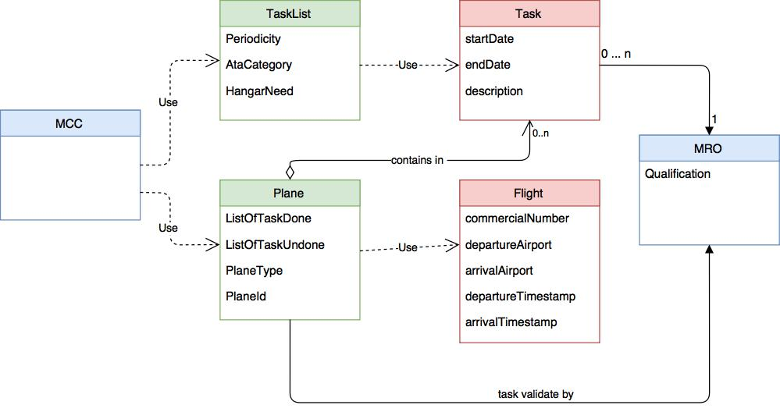
3 - Business Object

Slide 5
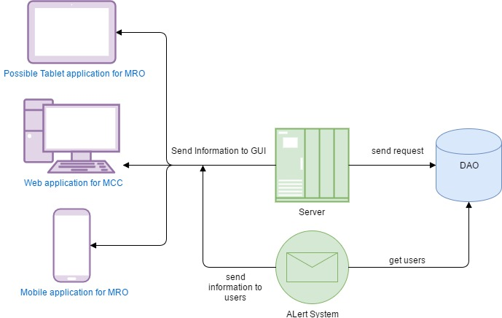
4 - Technical diagram

Slide 6
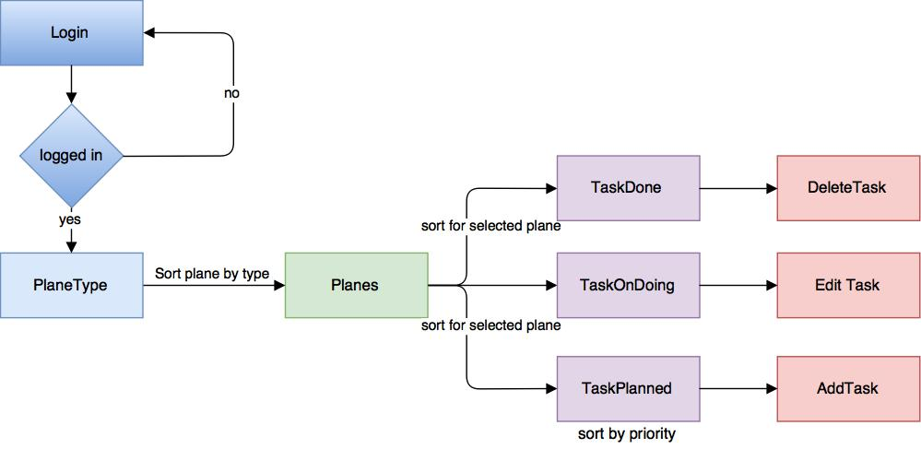
5 - Navigation diagram : MCC interface

Slide 7
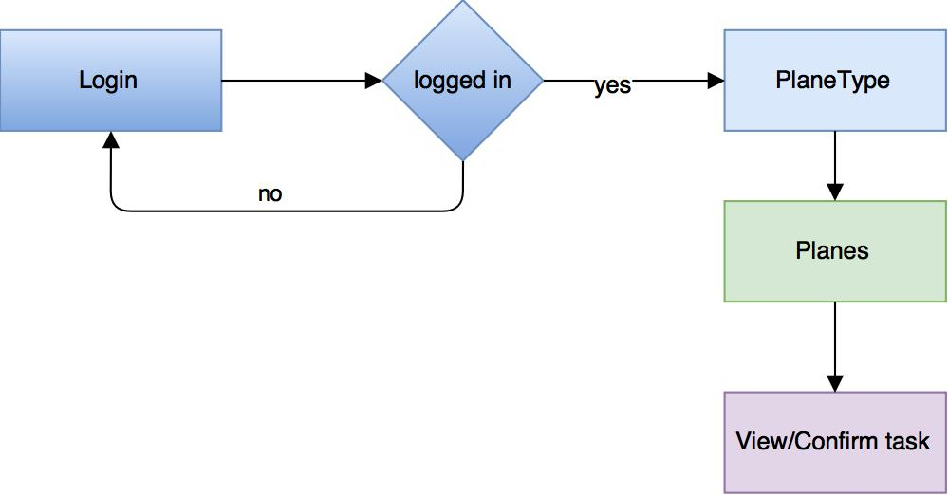
5 - Navigation diagram : MRO interface

Slide 8
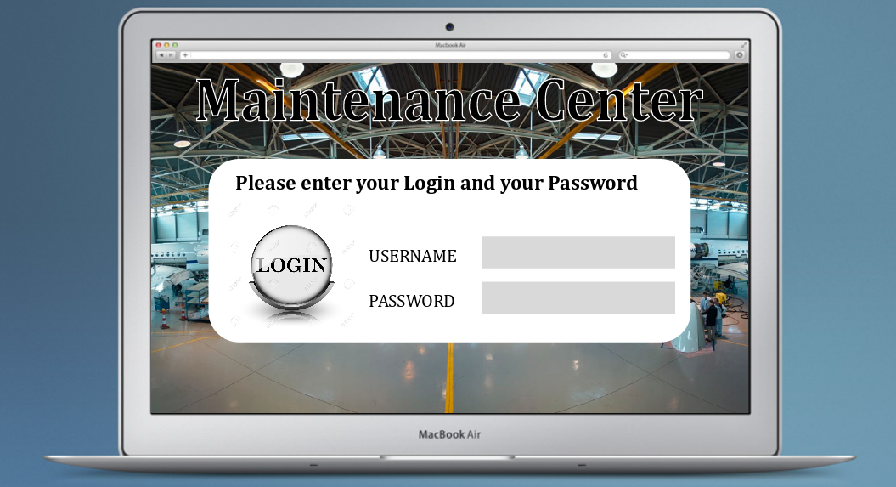
6 - Mockups : homepage/log-in

Slide 9
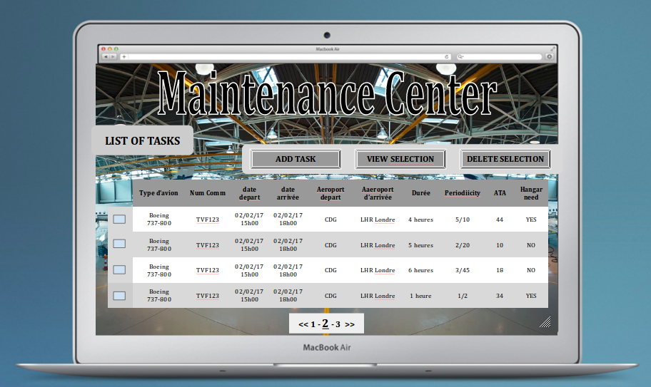
6 - Mockups : task list

Slide 10
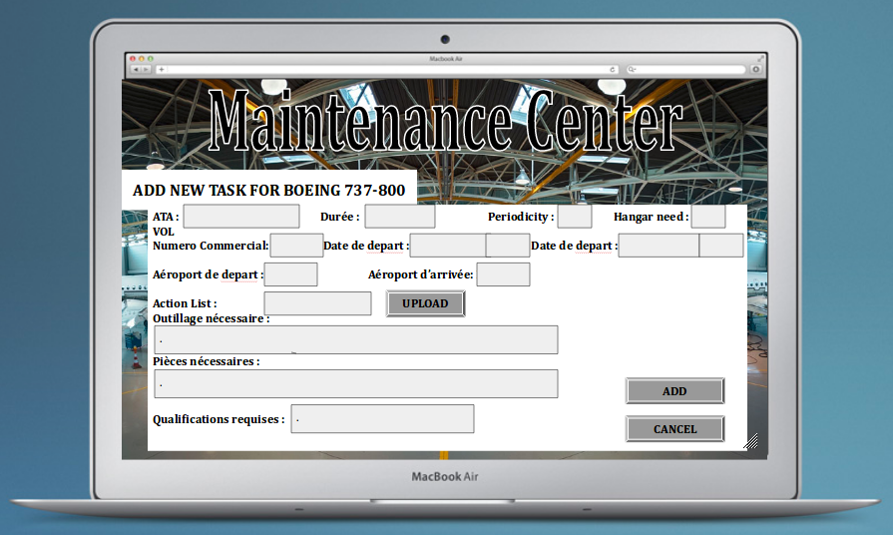
6 - Mockups : add task

Slide 11
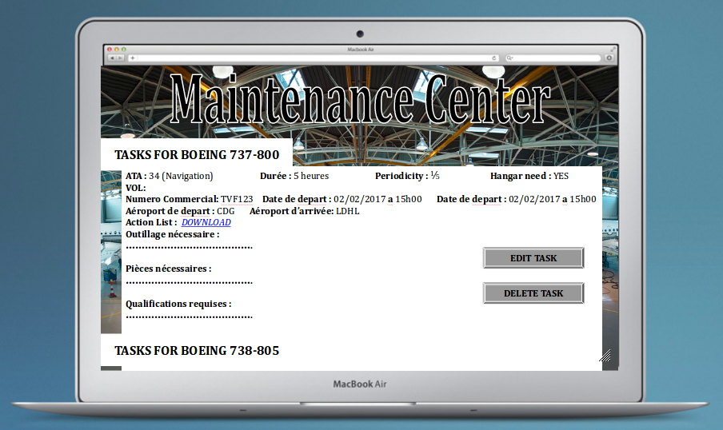
6 - Mockups : view task

Slide 12
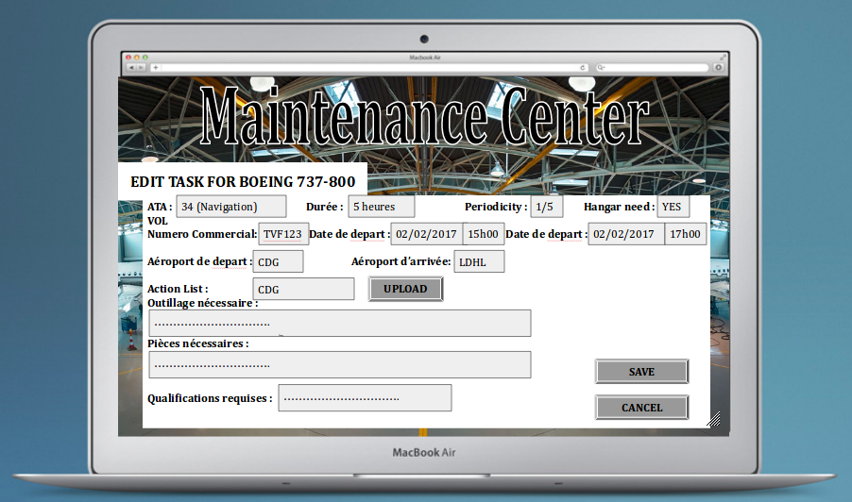
6 - Mockups : edit task

Slide 13
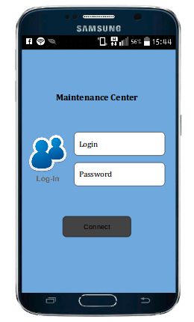
6 - Mockups mobile : login

Slide 14
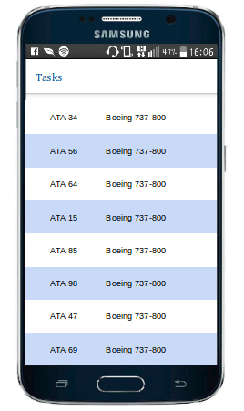
6 - Mockups mobile : task list

Slide 15
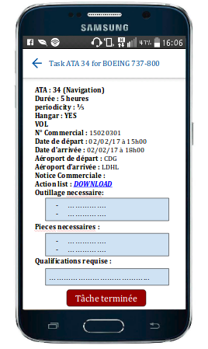
6 - Mockups mobile : view task

Slide 16
7 - Web services
Type | URL | Behavior
GET | /task/{user_id} | Returns a list of tasks by user's role
GET | /task/{task_id} | Returns all the properties of a task
POST | /task/add/ | Add one new task
POST | /task/modify/{task_id} | Modify all the properties of a task
PUT | /task/update/{task_id} | Update one field of a task
DELETE | /task/delete/{task_id} | Delete a task
GET | /ata/view/{ata_id} | Return an ATA document

Slide 17
7 - Web services
Type | URL | Behavior
GET | /flight/view/{flight_id} | Return all the properties of a flight
GET | /aircraft/view/{aircraft_id} | Return all the properties of a physic airplane
GET | /aircraft/view/{aircraft_id}/tasks | Return all tasks for a specific airplane

Slide 18
Project members
Diallo Mohamed
Sy Amadou
Ingani Jude
Hamadi Krimo
Fekih Ahmed Meriem
Kaba Saran
Yung-kun Hsieh
Diabira Binta
Oulebsir Hocine

